Slide 1
VIDEO SCENE CLASSIFICATION SYSTEM
Presented By:
Shubham Singh Karki – 2119234 (SEC M)
Vimal Singh Panwar – 2119423 (SEC B)
Yugraj – 2119460 (SEC B)
Rishab Thapliyal – 2119013 (SEC J)

Slide 2
CONTENTS
Introduction
Problem Statement
Objectives
Working
Model Architecture / How it works? (NLP + CLIP)
Sample Results
Applications
Future Scope

Slide 3
INTRODUCTION
This project aims to simplify video navigation by enabling users to search for specific scenes using natural language queries like “show me the forest scene.
The system identifies and returns the exact timestamp of the scene, making it easier to access relevant content quickly and efficiently.
This makes the video navigation experience faster, smarter, and user-friendly, with applications in media editing, education, surveillance, and content creation.

Slide 4
PROBLEM STATEMENT
Exponential Video Growth: Rapid increase in video content makes locating
specific scenes challenging.
Manual Navigation: Manually searching for scenes in long videos is
time-consuming and inefficient.
Limited Search Systems: Current systems rely on metadata or manual tagging,
which are often incomplete or inflexible.
Lack of Natural Language Support: Existing solutions struggle to interpret
intuitive, natural language queries.
Industry Applications: Need for precise scene retrieval in fields like
entertainment, education, and law enforcement.

Slide 5
OBJECTIVES
To develop a system to locate specific video scenes using natural language
queries.
To implement an efficient machine learning model for high-accuracy scene
classification.
Integration of NLP to match user queries with predefined scene categories.
A user-friendly interface.

Slide 6
WORKING
Video Upload and Preprocessing
  User uploads video via web interface. The system uses OpenCV to extract frames
  and divides video into segments or shots for manageable processing.
Scene Classification
  Pre-trained deep learning model classifies the content of each segment or
  key frame. CLIP multimodal model analyzes spatial and temporal features for
  accurate scene recognition. Scenes are labeled (e.g., “mountains," "city") and
  stored with corresponding timestamps.

Slide 7
Query Processing with NLP
  User inputs natural language query (e.g., "Show me the ocean scene").
  NLP model interprets query, matches it to predefined scene labels,
  and handles synonyms/variations.
Scene Search and Matching
  System searches pre classified video for scenes matching the query and retrieves
  timestamps of relevant scenes.
Video Navigation and Output
  Directs user to the specific scene timestamp.
  Moreover, allows manual navigation for flexible viewing of identified scenes.

Slide 8
HOW THE TEXT IS PROCESSED ?
Semantic Scene Matching - Core Functionality
Goal: The code identifies the best matching scene category for any given text query.
Key Technology: It leverages Sentence Embeddings to understand the meaning of both your query and a large list of predefined scene labels.
Model Used: A pre-trained Sentence Transformer model is employed (all-mpnet-base-v2) to convert text into powerful numerical vectors (embeddings).
Flexible Scene Categories: All potential scene descriptions are loaded from an external text file (scene_labels_2.txt), making the system easily expandable and adaptable.

Slide 9
How It Finds the Best Match
Embedding Creation:
  Every scene label from the file is converted into its unique numerical embedding (done once at startup).
  Your user query is also converted into an embedding in the same way.
Similarity Calculation:
  The system calculates cosine similarity between the query's embedding and all scene label embeddings.
  (Simply put: It measures how "similar" their meanings are in numerical space)
Results:
  The code identifies and presents the top matching scene labels with the highest similarity scores, giving you a clear, semantically relevant result.
Benefits:
  Highly Accurate: Finds matches based on deep semantic meaning, not just keyword overlap.
  Efficient: Rapid matching because it compares numerical vectors quickly.
  Scalable: Easily handle thousands of scene categories without performance issues.

Slide 10
HOW THE SCENES ARE CLASSIFIED ?
OpenCV: Extracts frames from the video.
CLIP (by OpenAI): Classifies scenes based on predefined categories.
PyTorch: Handles model computations.
WORKFLOW
  Load video and CLIP model.
  Process frames at 1 FPS (skip frames based on video FPS).
  Convert frames to RGB and preprocess for CLIP
  Compare frame features with text descriptions of scenes.
  Display predicted scene and confidence score.

Slide 11
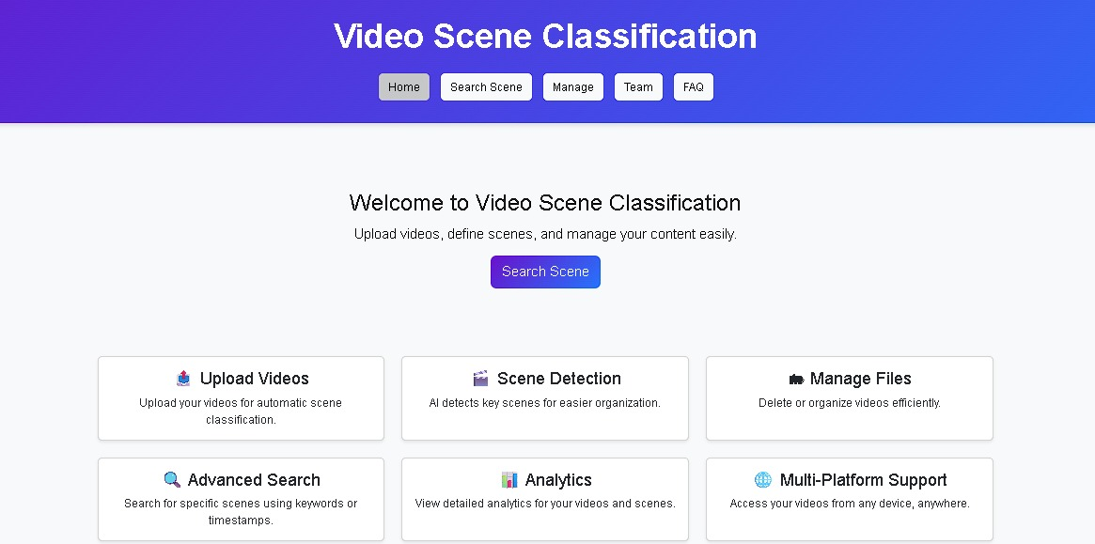

SAMPLE RESULTS

Slide 12
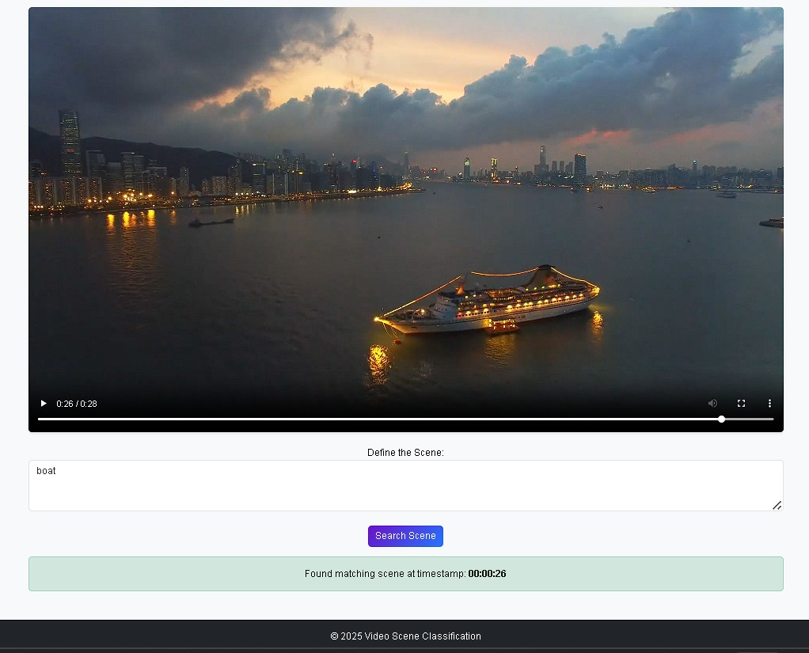

Slide 13
APPLICATIONS
Entertainment and Media: Enabling editors, producers, and journalists to quickly locate specific scenes in large video libraries, streamlining post-production workflows and creating highlight reels or simplified content access for users.
Education: Facilitating teachers and students in searching lecture recordings or educational videos for specific topics or scenes, enhancing learning efficiency.
Corporate Training and Archiving: Allowing quick retrieval of relevant sections in training videos or corporate event recordings, improving knowledge access and usability.
Content Creators and Social Media: Helping influencers and creators efficiently find scenes from footage for repurposing into social media content, trailers, or advertisements.
Law Enforcement and Surveillance: Assisting officers and analysts in rapidly identifying critical moments in surveillance footage for efficient event analysis.

Slide 14
FUTURE SCOPE
Expanded Scene Categories: Incorporate a broader range of scene types (e.g., emotions, or objects) to enhance classification granularity.
Real-Time Processing: Develop capabilities for real-time scene classification and search in live video streams, such as broadcasts or surveillance feeds.
Integration with Video Platforms: Enable seamless integration with popular video platforms (e.g., YouTube, Vimeo) for direct scene search within their ecosystems.
Multi-Modal Search Enhancements: Combine audio, text, and visual analysis to support more complex queries (e.g., "scene with a dog barking”)
Cross-Language Support: Enhance NLP to support queries in multiple languages, making the system accessible to a global audience.
AI Model Optimization: Improve deep learning models for faster processing and lower resource consumption, enabling deployment on low-end devices.
Industry-Specific Customization: Tailor the system for specialized applications, such as medical video analysis or sports highlight detection, to meet niche industry needs.

Slide 15
THANK YOU

